Slide 1

Reinforcement Learning
By Mohsin Ali Mirza

Slide 2




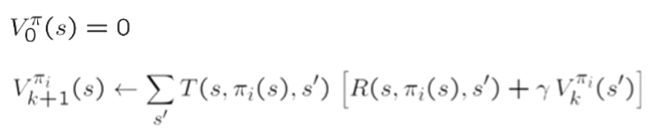

Recap
Equations
Bellman
Value Iter
Policy Extraction
Policy Evaluation
Policy Improvement
Dictionary
States
Actions
Policy
Transitions
Q-States
Rewards
Utility
Values

Slide 3
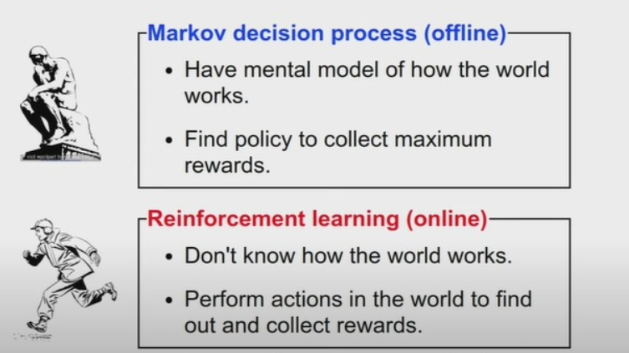
MDP VS Reinforcement Learning
Markov Decision Process
Reinforcement Learning
Reward Function is known
Transition Function is known
Reward Function is Unknown
Transition Function is Unknown

Slide 4
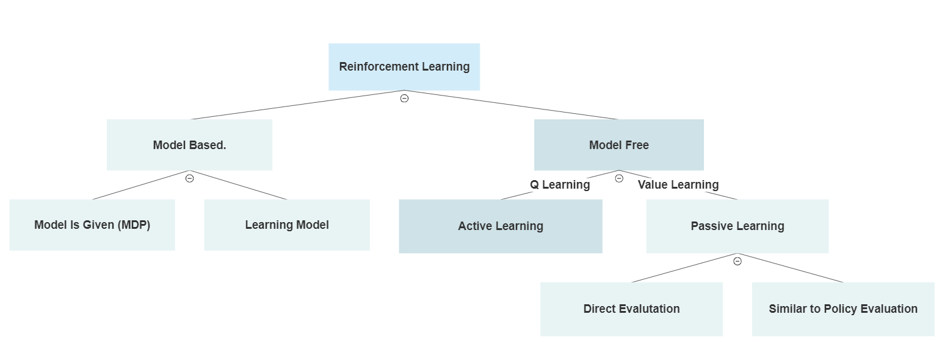
Reinforcement Learning Algorithms

Slide 5
Model Based Learning
Step 1: Learn Model (Hard Part)
Figure out what is s,a,s’ (Transitions/Probabilities)
Step 2: Solve the Model similar to MDP (Easy Part)
Apply Value Iteration (Mostly this)
Apply Policy Iteration

Slide 6
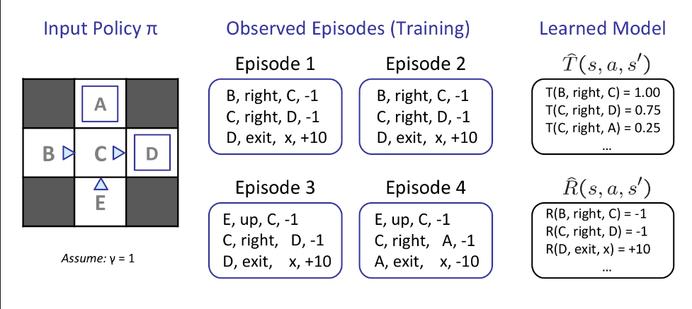


Example Grid World
$T(s,a,s’) = P = \frac{\# of (s,a.s’) }{\# of (s,a)}$
$T(B,right,C)=\frac{\# of (B,right,C) }{\# of (B,right)}=$ $\frac{ 2 }{2}=1$
$T(C,right,D)=\frac{\# of (C,right,D) }{\# of (C,right)}=$ $\frac{ 3 }{4}=0.75$
Notice reward is given but reward function is
still not defined.
The path you choose is known as an episode

Slide 7
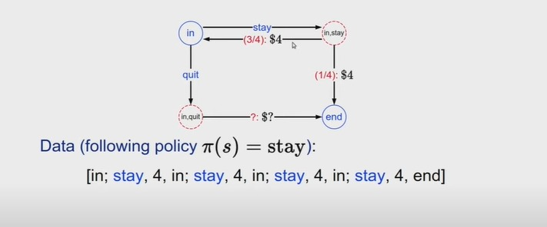
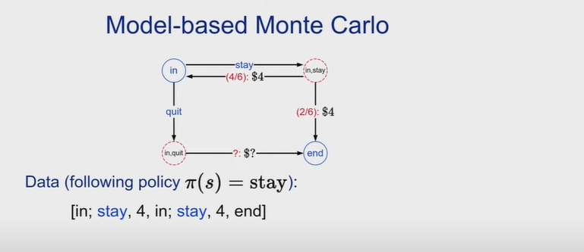
Example – Dice Game
Episodes
EP 1 = P(In,Stay,In)
EP 2 = P(In,Stay,In)
EP 3 = P(In,Stay,In)
EP 4 = P(In,Stay,End)
Episodes
EP 5 = P(In,Stay,In)
EP 6 = P(In,Stay,End)

Slide 8
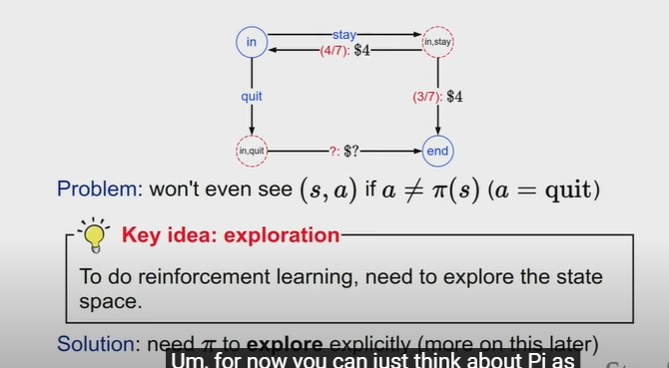
Example – Dice Game

Slide 9
Model Base Vs Model Free
In model base if you have a really strong model and you can defend it then thats the way to go but if you don’t have that then model free should be used.
In Deep Learning we use Model Free more
Neither Model Base or Model Free is superior

Slide 10
Model Free Learning
Passive Learning (Value Learning)
Learn Along Actions
Direct Evaluation
Similar to Policy Evaluation
Active Learning (Q-Learning)
Learner Makes Choices

Slide 11

Method 1: Direct Evaluation (Average Values)
Step 1: Choose a state D
Step 2: Calculate the value of that state in each episode till the path explained in the episode $V\left(D_{ep}\right)$
Step 3: Average all values calculated in step 3

Slide 12
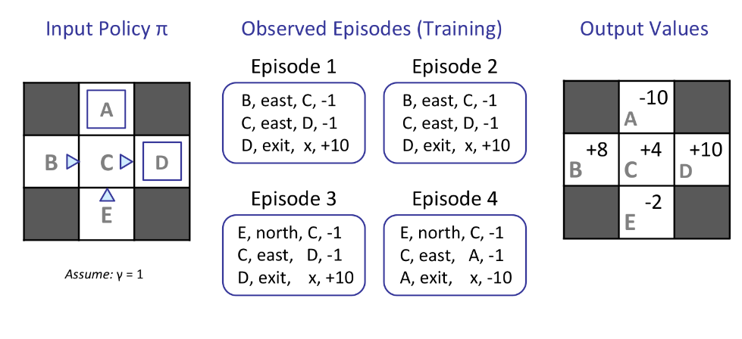

Method 1: Direct Evaluation (Average Values)
V$\left(s\right)=\frac{1}{N}⋅\sum_{i=ep}{V\left(s_{i}\right)}$
$V\left(c\right)=\frac{1}{4} [V\left(c_{ep1}\right)+V\left(c_{ep2}\right)+V\left(c_{ep3}\right)+V(c_{ep4})]$
$V\left(c_{ep1}\right)=−1+10=9$
$V\left(c_{ep4}\right)=−1−10=−11$
$V\left(c\right)=\frac{1}{4} [9+9+9−11]$
N = no of occurrences
$V\left(D\right)=\frac{1}{3} [10+10+10]$
(EXTRA)Why was T not used or Probabilities not used,
refer to age group example (28:06)

Slide 13
Problems with Direct Evaluation
Inconsistent, no correlation
From B to C and E to C both have 1 action
B has +8 but E has -2??(No Consistency)
From E you get -2 and C has +4??
Not optimal results unless
∞ Data and ∞ time
Collecting Data and Summarizing
In real life you have limited time

Slide 14

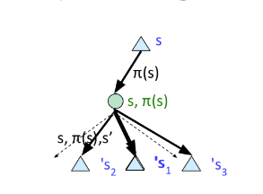
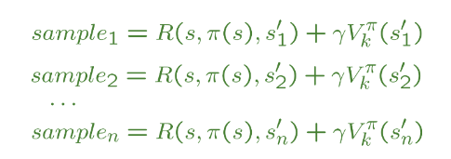




Policy Evaluation
Equations
Bellman
Value Itr
Policy Extraction
Policy Evaluation
Step 1: Recall Policy Evaluation Equation
We don’t know T or R
Step 2: Take Sample Of Data (Inner Bracket)
Step 3: Use Temporal Learning because can’t rewind time
Step 4: Compute the Value

Slide 15


Temporal Learning
Equations
Bellman
Value Itr
Policy Extraction
Policy Evaluation
Temporal Passive
Policy is fixed and just need to evaluate it
Running Average
Assumption is with time and experience
the agent will get better
$α$ = low means more priority or importance to old data
For deep learning students

Slide 16
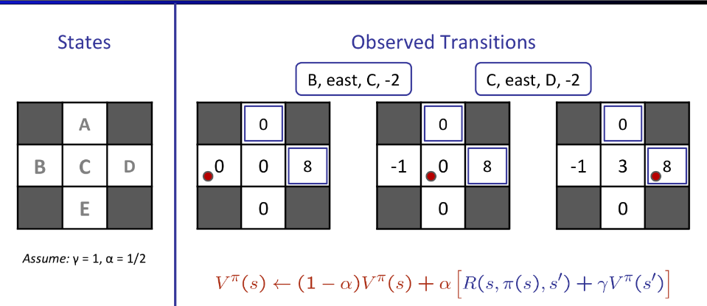

Example – Grid World
Step 2: Collect Sample
B,east,c, -2
-2 + 1(c) = -2+0 = -2 (living)
Step 3: Temporal Learning
V(c) = 0.5(0) + 0.5(-2) = -1
Step 4: Average
No other samples given

Slide 17
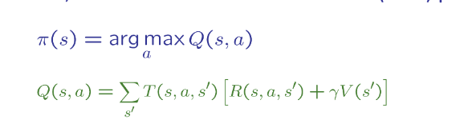
Problems with Temporal Difference
Once Policy Evaluation is done we need to improve it i.e
We don’t know T and R again so??
That means solving value was not a good option instead
We need to do Q-Learning / Active Learning

Slide 18
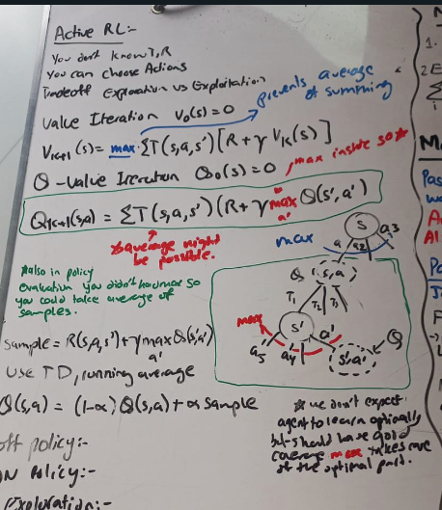

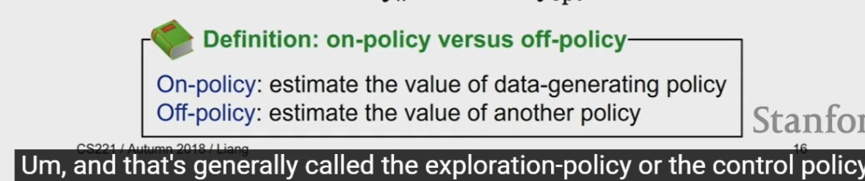
Active Learning
Equations
Bellman
Value Itr
Policy Extraction
Policy Evaluation
Temporal Passive
Similar To Value Iteration, we will use Q Value Iteration
Collect Sample: (Inner Bracket)
Apply Temporal Average

Slide 19
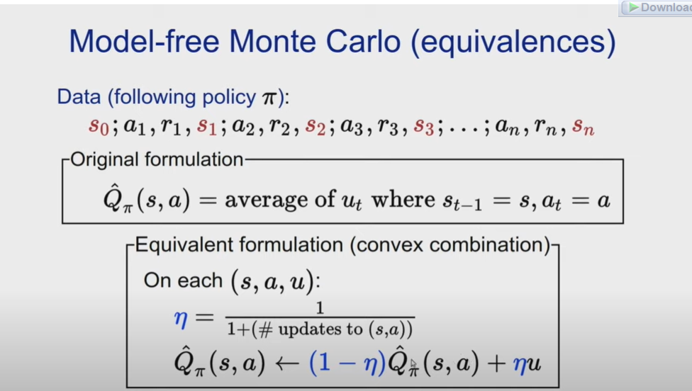
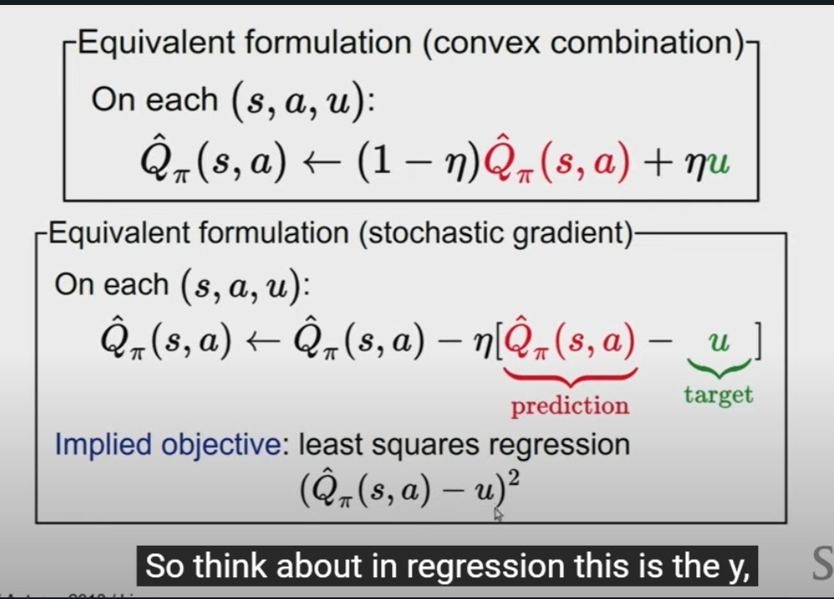
(EXTRA) Monte Carlo Model Free

Slide 20
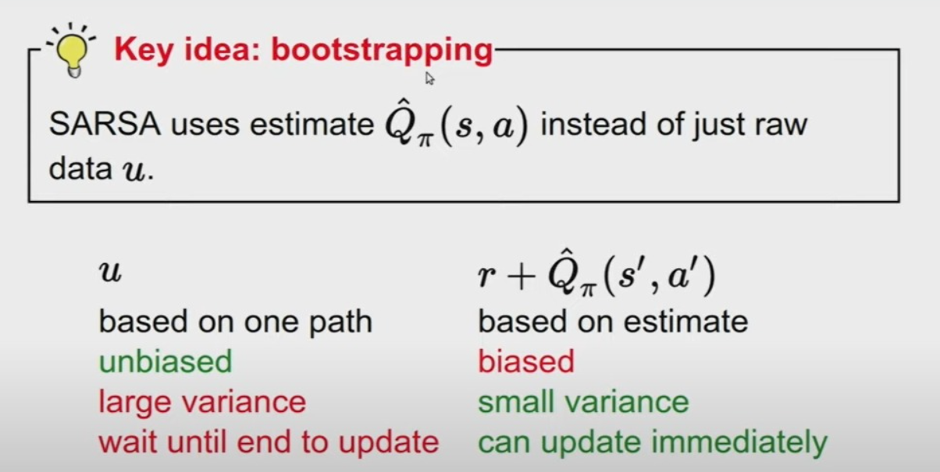
(Extra) Monte Carlo Vs SARSA

Slide 21
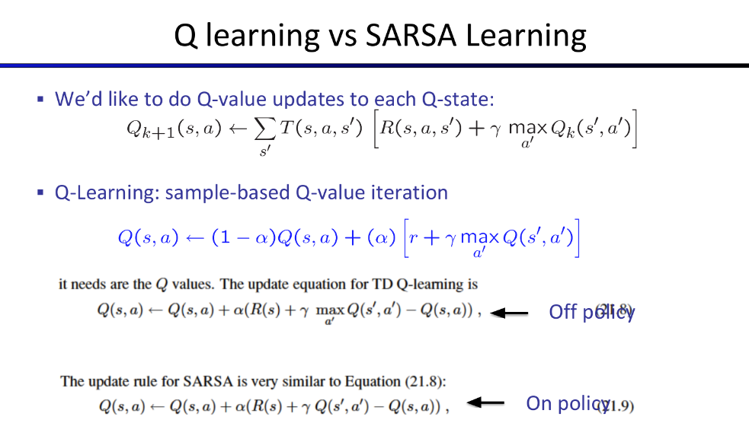

Slide 22
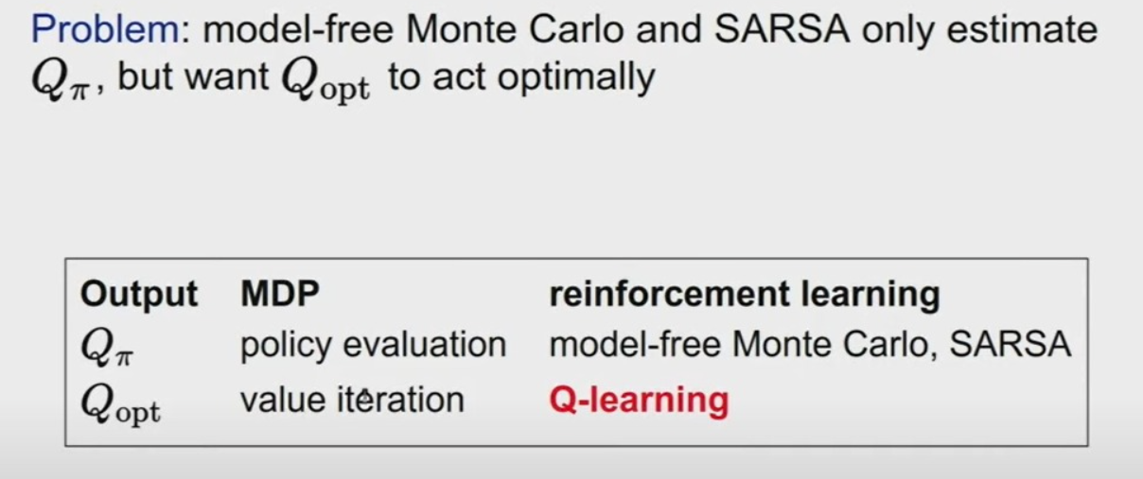
Overview

Slide 23
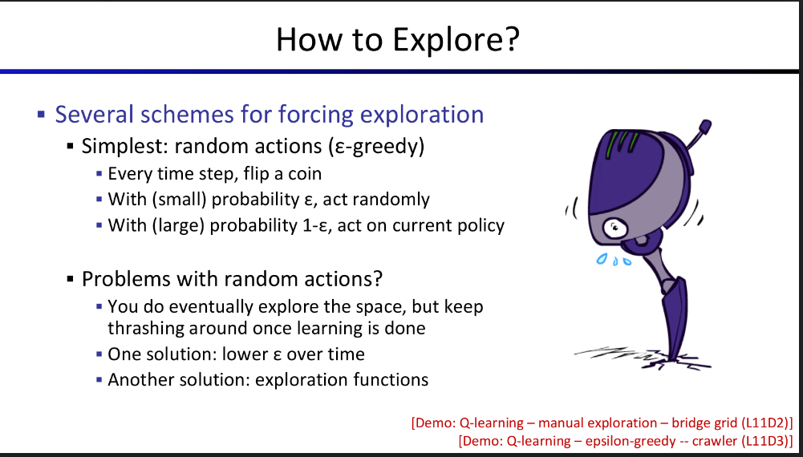

Slide 24

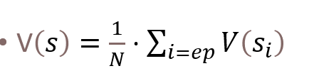

Equations
Model Based:
Model Free Direct Evaluation:
Equations
Bellman
Value Iter
Policy Extraction
Policy Evaluation
Policy Improvement
Temporal Passive
Policy Average Passive
Q-Value Iter
Temporal Active

Slide 25
Deep Reinforcement Learning

